Slide 1
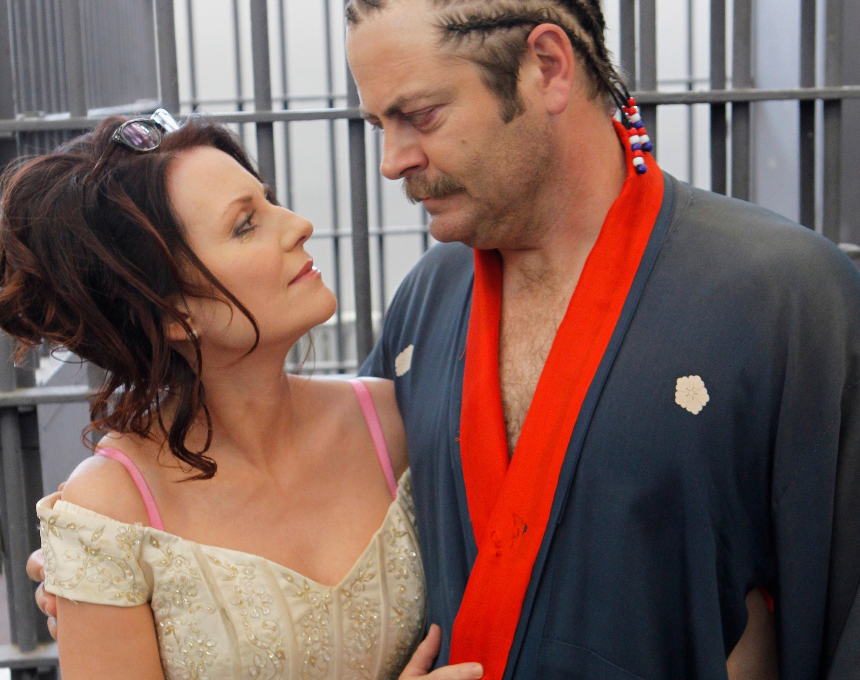
Divorce Prediction Survey
Team: Paul S, Dan E, Rose I, Michael N

Slide 2
The Dataset
We found our data on UCI, it comes from research done in Turkey
The collection of 54 questions are answered on a scale from 0-4 and then put directly into a spreadsheet along with a column representing their status (1=divorced, 0=married)
The population was of 170 couples, divided at 49% divorced and 51% married

Slide 3
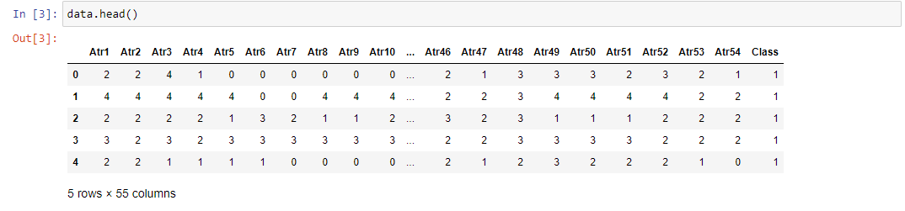
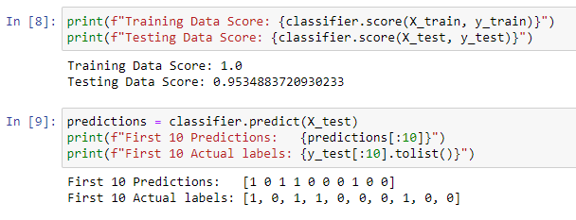

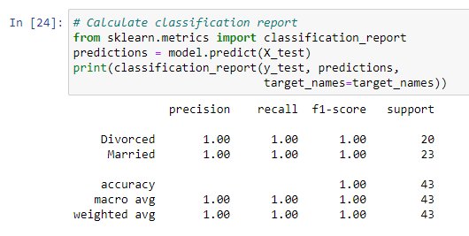

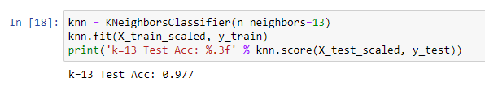
Fortunately for us, the data came in clean and ready to go. This allowed us to jump right in and get to training.
We thought we were doing something wrong to see such high prediction power, it persisted to be accurate through a variety of methods. We consulted the primary research and found that they too had >90% accurate model!

